Slide 2
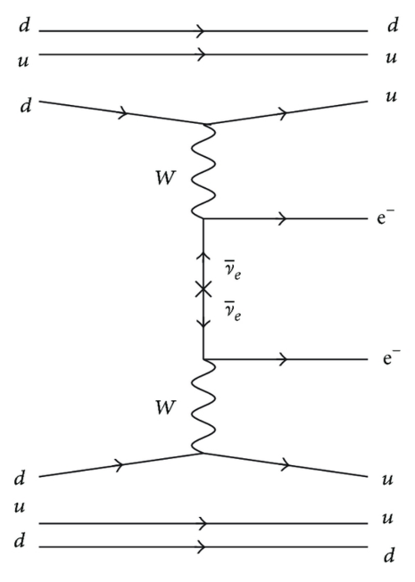
Search for Neutrinoless Double-Beta Decay 0νββ of ⁷⁶Ge
Neutrinoless double-beta decay could provide insights into physics beyond the Standard Model
1

Slide 3
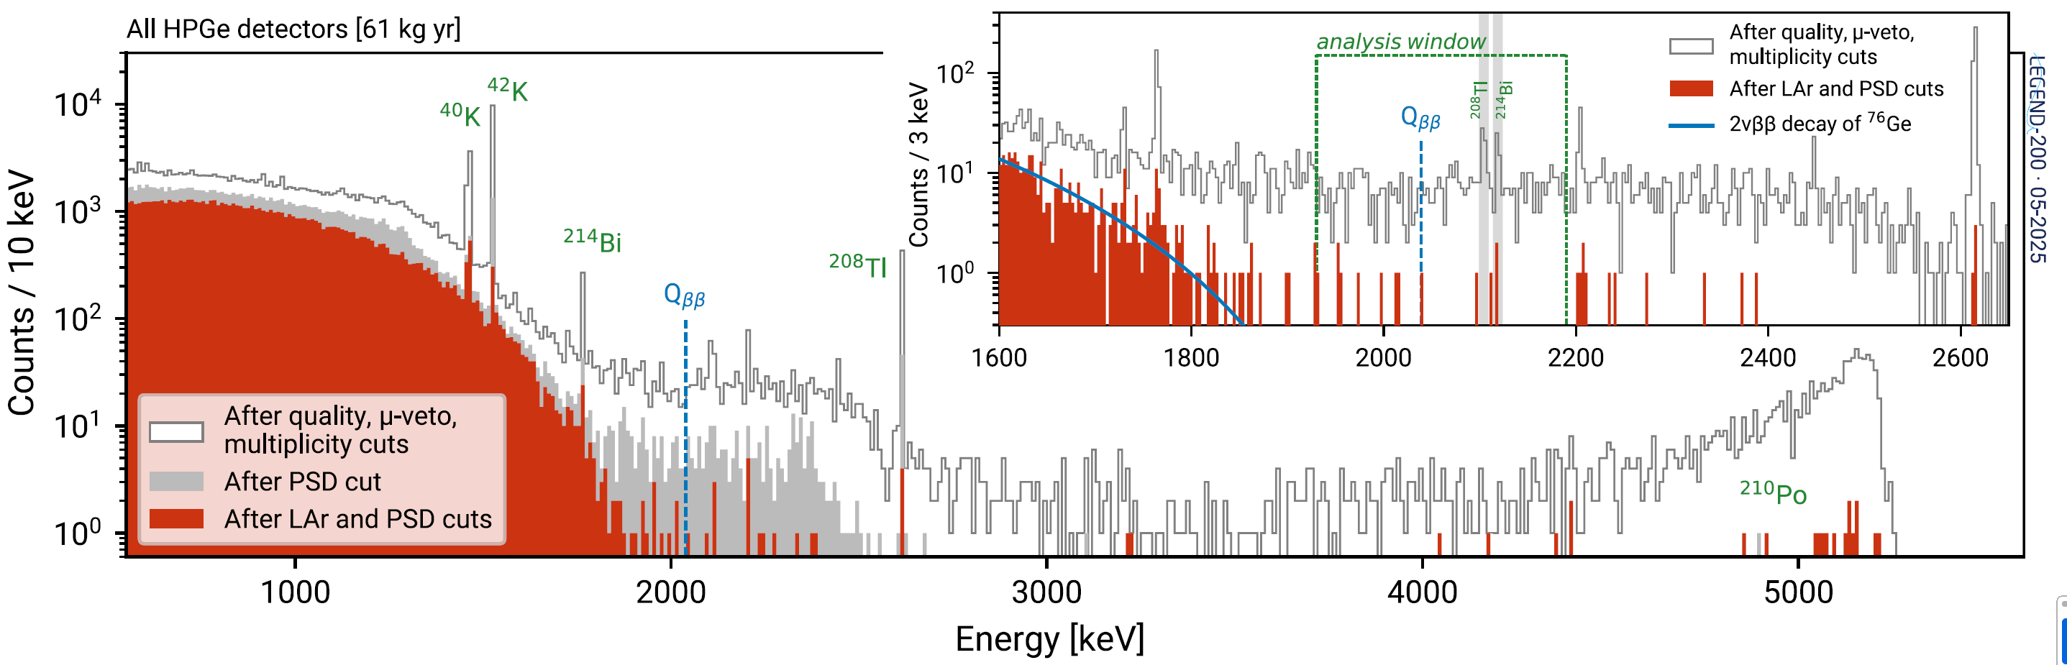
Search for Neutrinoless Double-Beta Decay 0νββ of ⁷⁶Ge
Neutrinoless double-beta decay could provide insights into
physics beyond the Standard Model
Searching for 0νββ decay of ⁷⁶Ge (Q_{ββ} = 2039 keV) in LEGEND
PRL136, 022701 (2026)
2

Slide 4
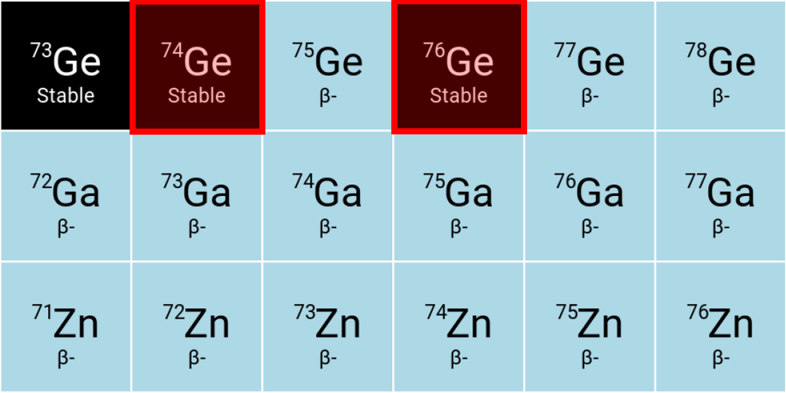
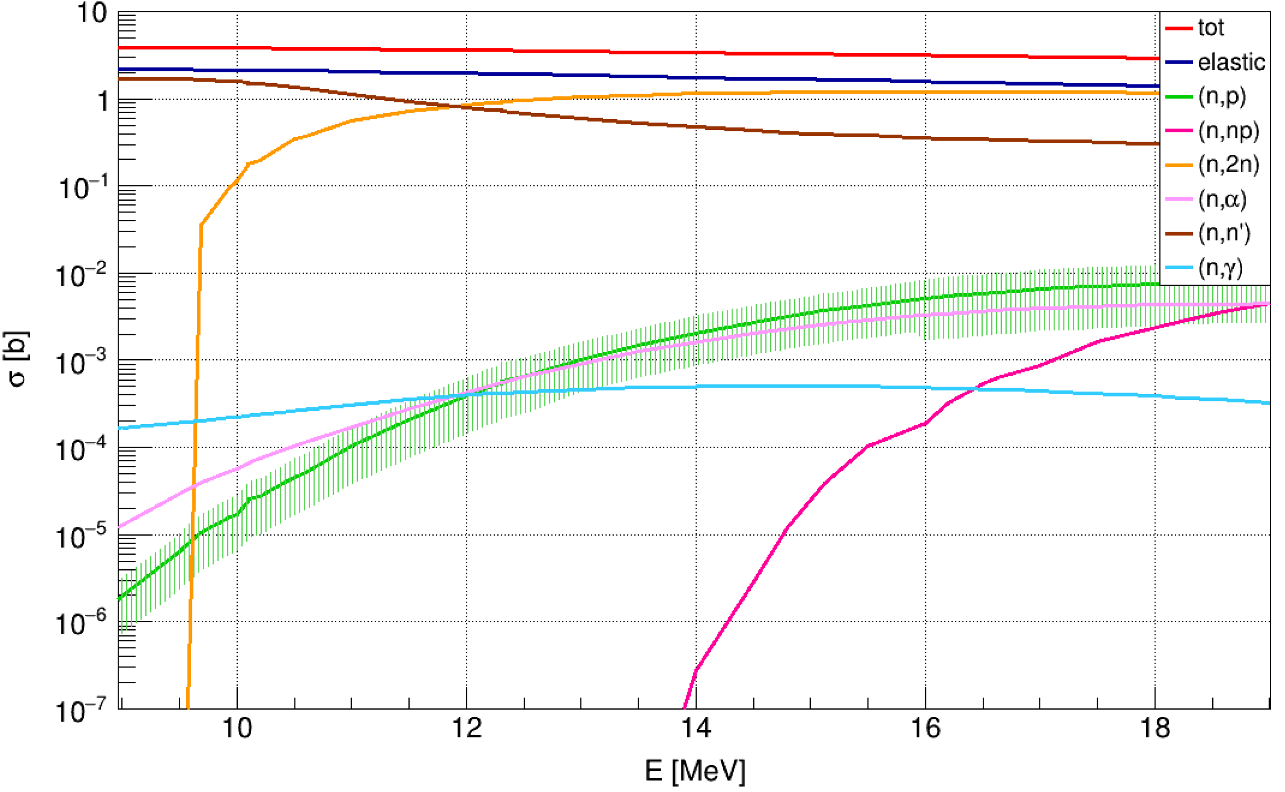
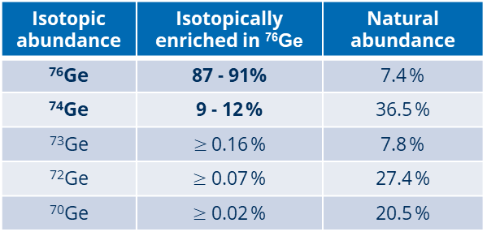
Neutron-Induced γ Rays in the ⁷⁶Ge 0νββ Signal Region?
Background contribution from enriched Ge due to neutron activation of ⁷⁶Ge and ⁷⁴Ge
Neutron cross sections ⁷⁶Ge
Isotopic abundance | Isotopically enriched in ⁷⁶Ge | Natural abundance
⁷⁶Ge | 87 - 91% | 7.4 %
⁷⁴Ge | 9 - 12 % | 36.5 %
⁷³Ge | $≥$0.16 % | 7.8 %
⁷²Ge | $≥$ 0.07 % | 27.4 %
⁷⁰Ge | $≥$ 0.02 % | 20.5 %
3

Slide 5
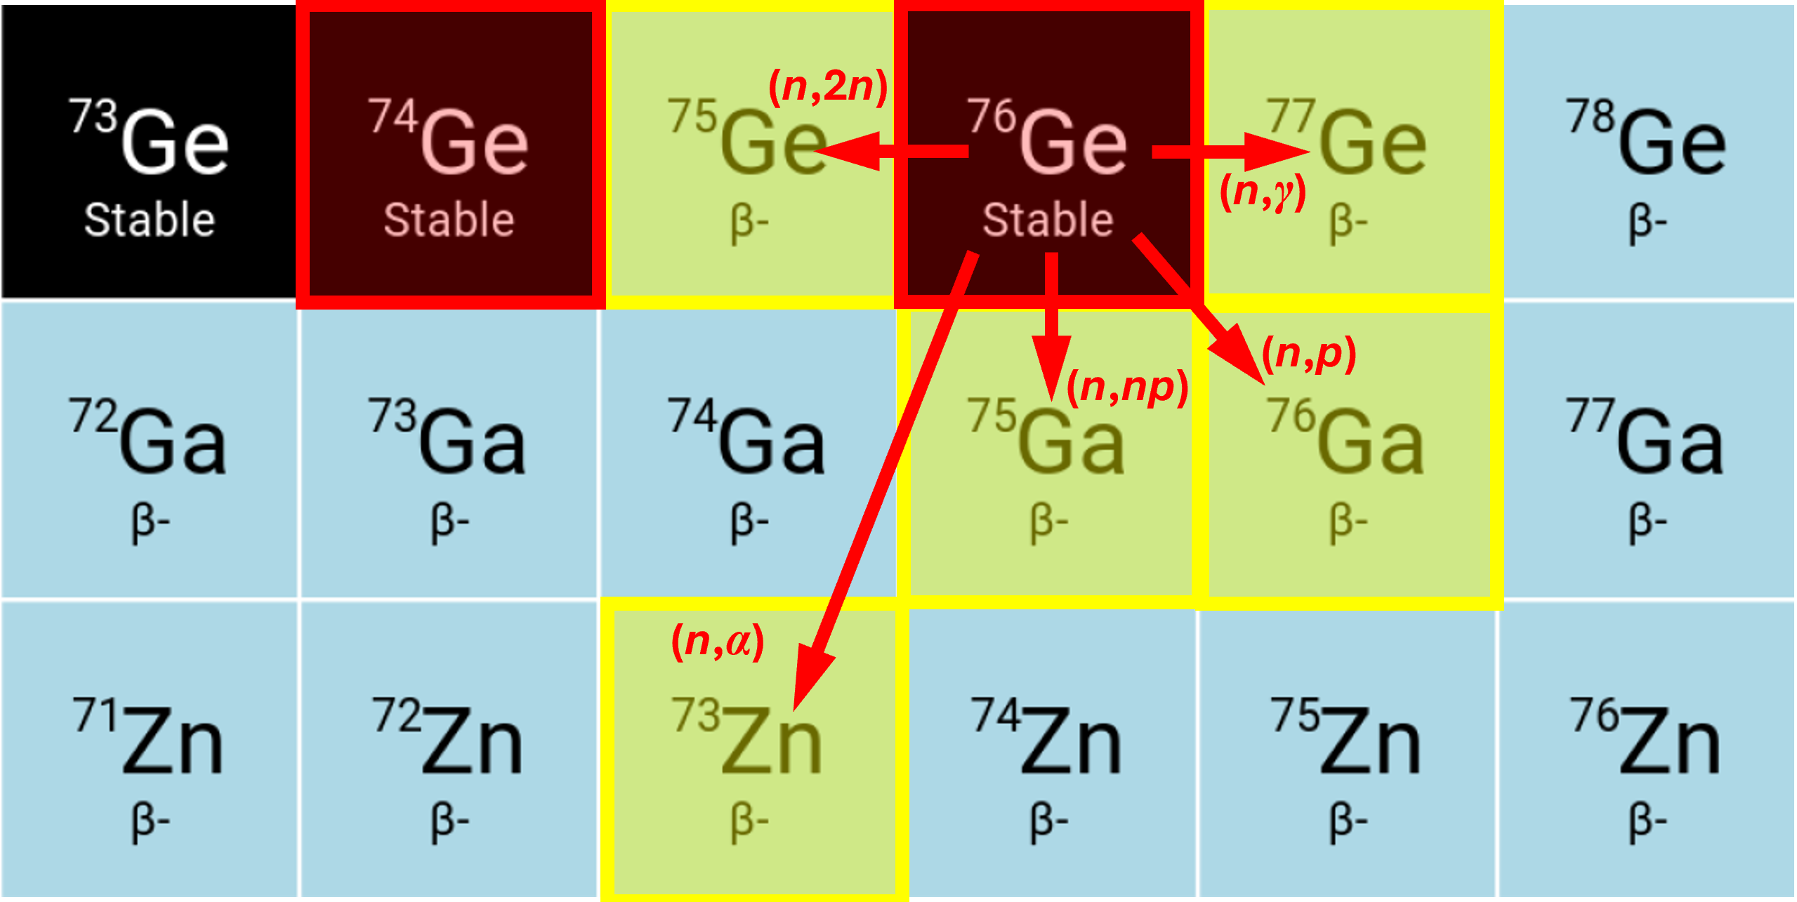
Neutron-Induced γ Rays in the ⁷⁶Ge 0νββ Signal Region?
Background contribution from enriched Ge due to neutron activation of ⁷⁶Ge and ⁷⁴Ge
Neutron cross sections ⁷⁶Ge
Isotopic abundance | Isotopically enriched in ⁷⁶Ge | Natural abundance
⁷⁶Ge | 87 - 91% | 7.4 %
⁷⁴Ge | 9 - 12 % | 36.5 %
⁷³Ge | $≥$0.16 % | 7.8 %
⁷²Ge | $≥$ 0.07 % | 27.4 %
⁷⁰Ge | $≥$ 0.02 % | 20.5 %
3

Slide 6
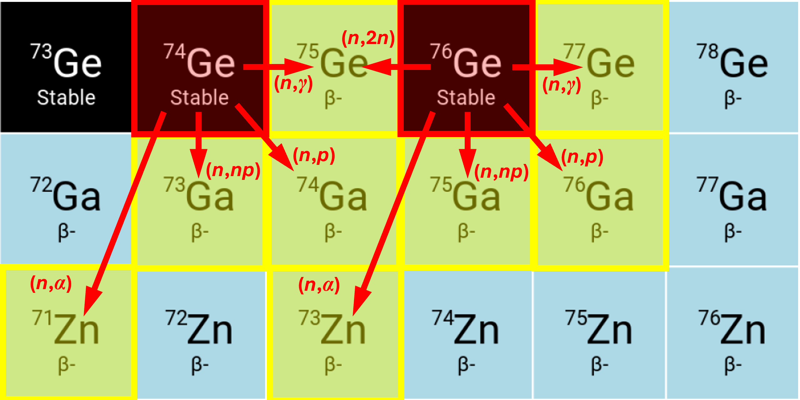
Neutron-Induced γ Rays in the ⁷⁶Ge 0νββ Signal Region?
Background contribution from enriched Ge due to neutron activation of ⁷⁶Ge and ⁷⁴Ge
Neutron cross sections ⁷⁶Ge
Isotopic abundance | Isotopically enriched in ⁷⁶Ge | Natural abundance
⁷⁶Ge | 87 - 91% | 7.4 %
⁷⁴Ge | 9 - 12 % | 36.5 %
⁷³Ge | $≥$0.16 % | 7.8 %
⁷²Ge | $≥$ 0.07 % | 27.4 %
⁷⁰Ge | $≥$ 0.02 % | 20.5 %
3

Slide 7
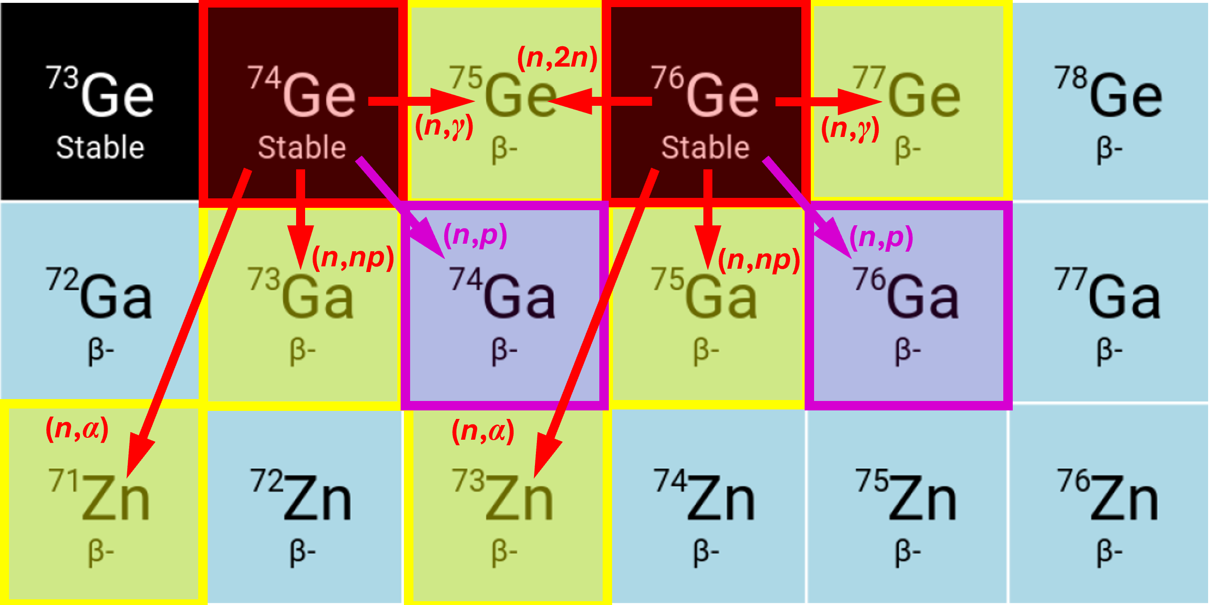
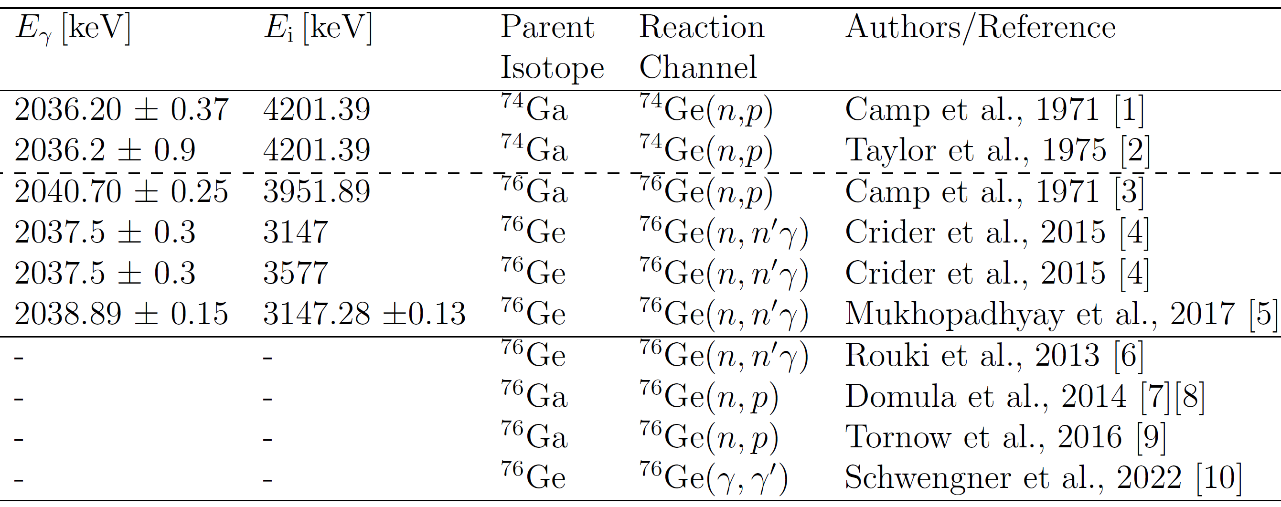
Neutron-Induced γ Rays in the ⁷⁶Ge 0νββ Signal Region?
Background contribution from enriched Ge due to neutron activation of ⁷⁶Ge and ⁷⁴Ge
Aim of this work: investigate potential γ-ray background near 2039 keV in isotopically enriched Ge
Q_{ββ} = 2039 keV
T_{½} = 8.12 min
T_{½} = 30.5 s
4

Slide 8
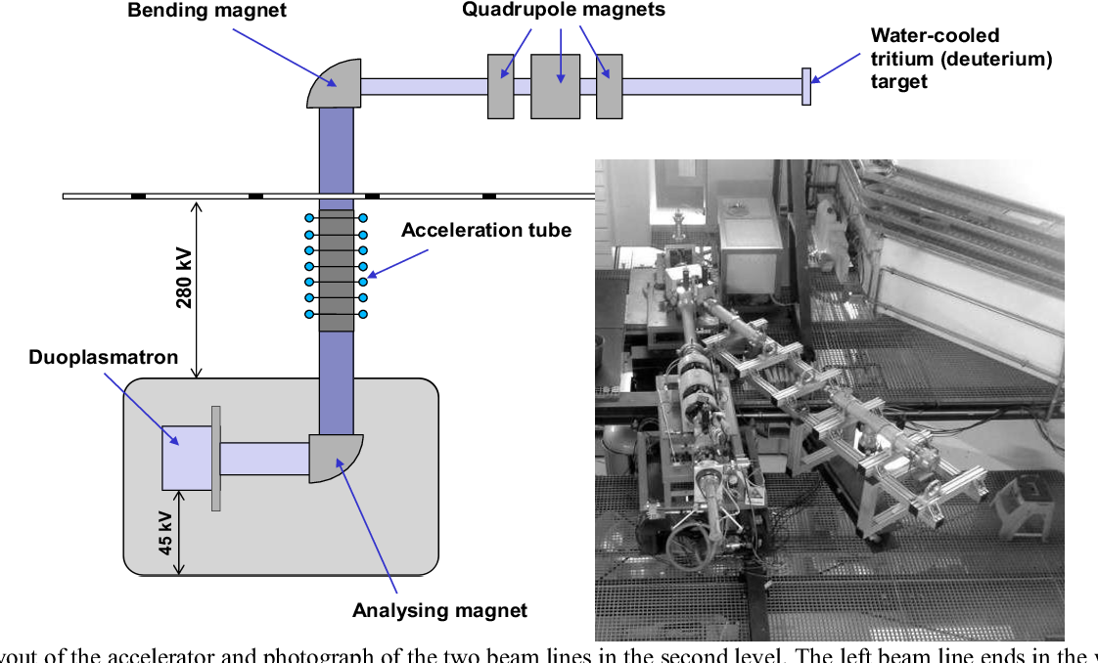
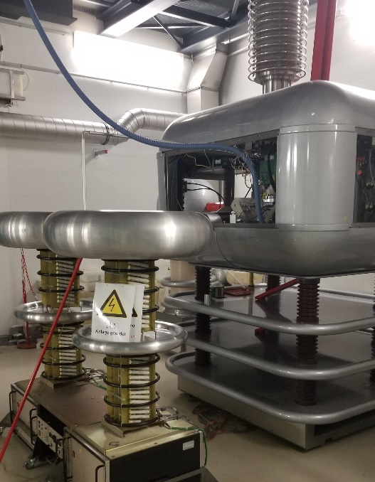
Experimental Setup
DT neutron
generator
Sample irradiation at DT neutron generator of TU Dresden
Produces 14.1 MeV quasi-monoenergetic neutrons
5

Slide 9
Experimental Setup
DT neutron
generator
HK 33.7
Sample irradiation at DT neutron generator of TU Dresden
Produces 14.1 MeV quasi-monoenergetic neutrons
5

Slide 10

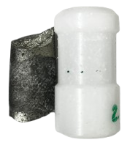
Experimental Setup
DT neutron
generator
HK 33.7
Sample irradiation at DT neutron generator of TU Dresden
Produces 14.1 MeV quasi-monoenergetic neutrons
7 enriched ⁷⁶Ge samples (~120 g in total)
Within borated PE transportation shuttles
5

Slide 11
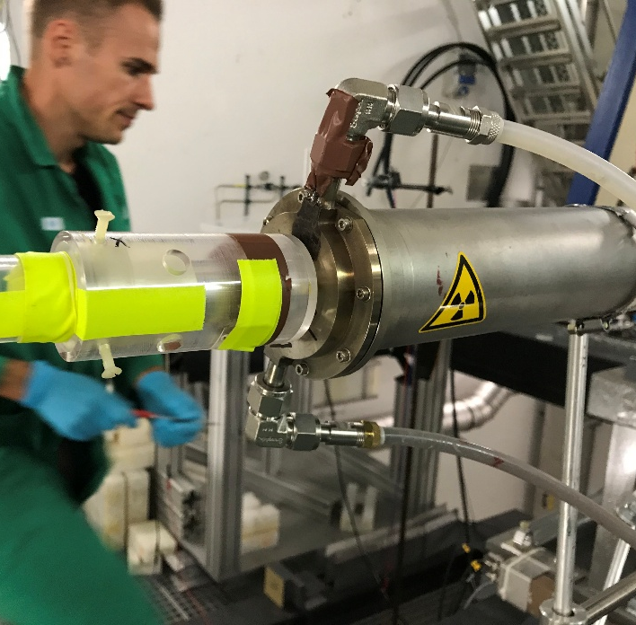
Experimental Setup
DT neutron
generator
HK 33.7
Sample irradiation at DT neutron generator of TU Dresden
Produces 14.1 MeV quasi-monoenergetic neutrons
7 enriched ⁷⁶Ge samples (~120 g in total)
Within borated PE transportation shuttles
5

Slide 12

Experimental Setup
DT neutron
generator
HK 33.7
Sample irradiation at DT neutron generator of TU Dresden
Produces 14.1 MeV quasi-monoenergetic neutrons
7 enriched ⁷⁶Ge samples (~120 g in total)
Within borated PE transportation shuttles
5

Slide 13

Experimental Setup
DT neutron
generator
HK 33.7
Sample irradiation at DT neutron generator of TU Dresden
Produces 14.1 MeV quasi-monoenergetic neutrons
7 enriched ⁷⁶Ge samples (~120 g in total)
Within borated PE transportation shuttles
5

Slide 14
Experimental Setup
DT neutron
generator
Pneumatic tube system
~
Detection
setup
6

Slide 15

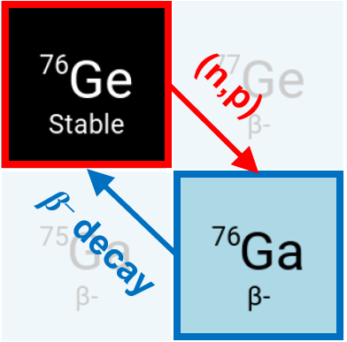
Experimental Setup
DT neutron
generator
90 s Irradiation
T_{½} = 30.5 s
Pneumatic tube system
~19 s transportation
Detection
setup
6

Slide 16
Experimental Setup
DT neutron
generator
90 s Irradiation
Pneumatic tube system
~19 s transportation
Detection
setup
6

Slide 17
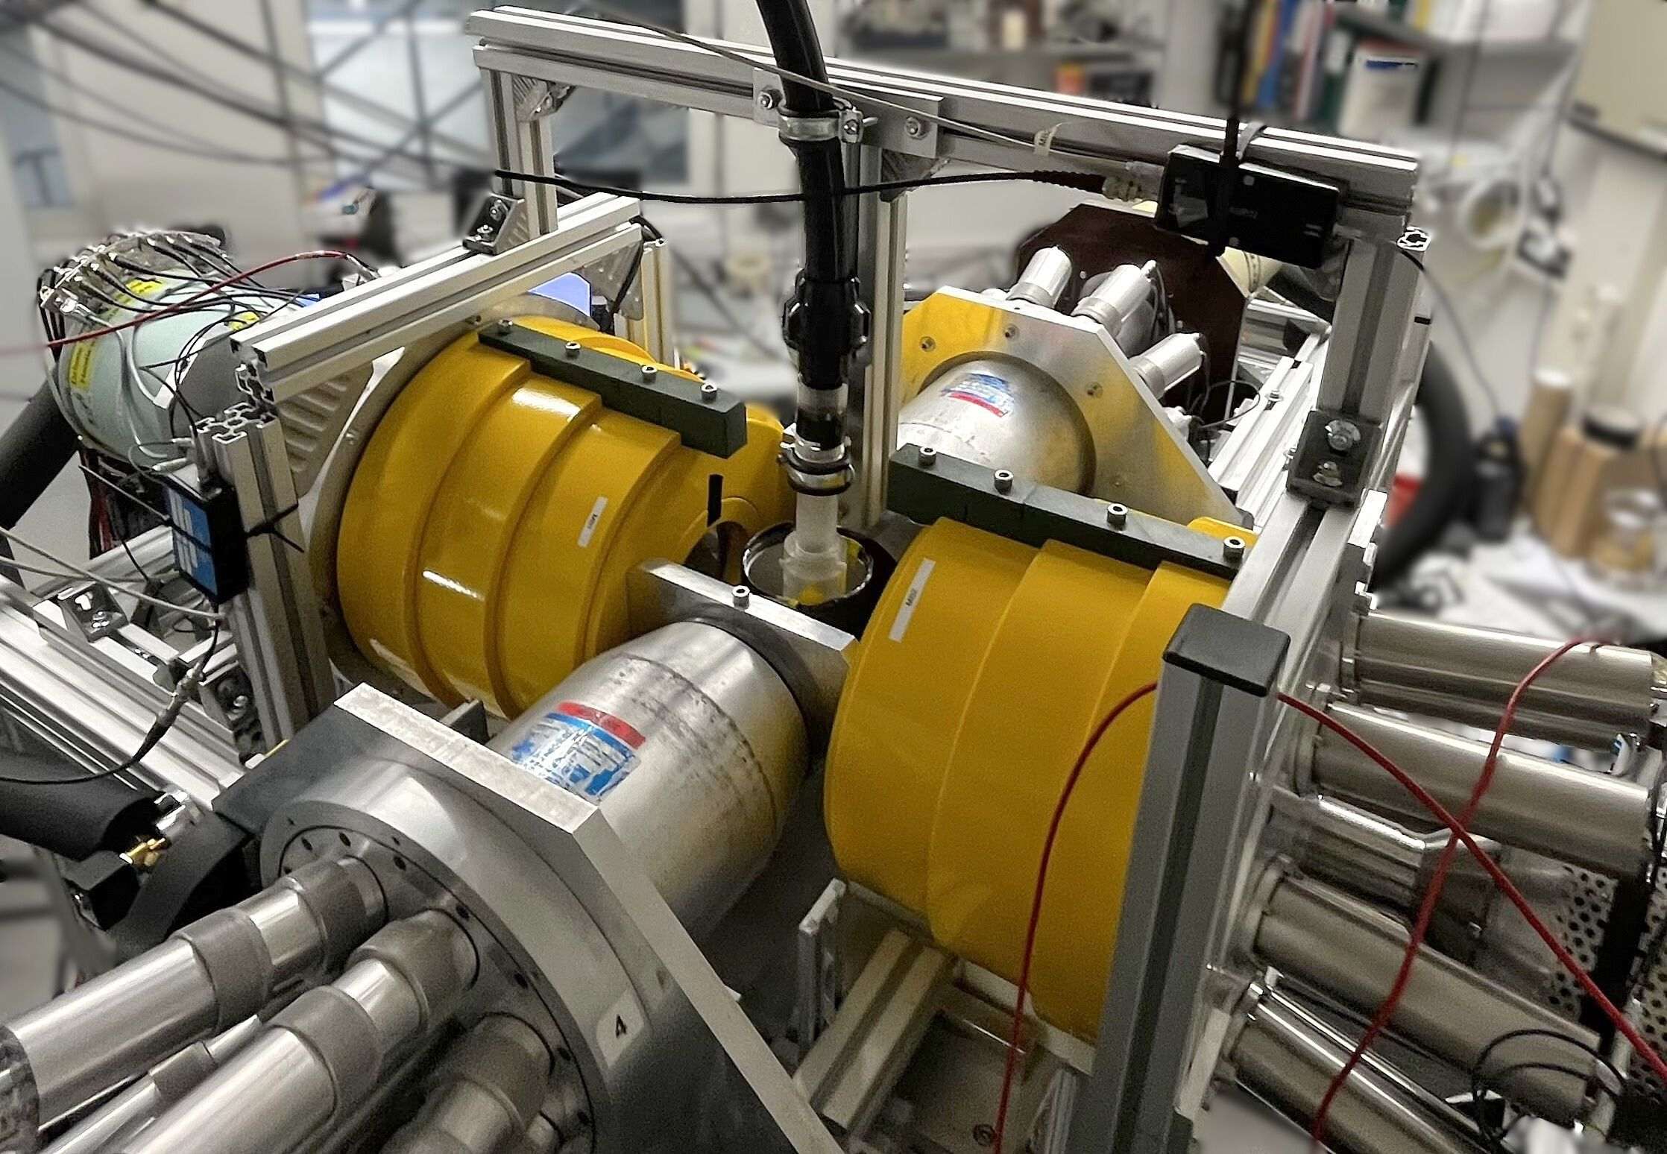
Experimental Setup
DT neutron
generator
90 s Irradiation
Pneumatic tube system
~19 s transportation
Detection
setup
60 s measurement
7

Slide 18


Experimental Setup
DT neutron
generator
90 s Irradiation
Pneumatic tube system
~19 s transportation
Detection
setup
60 s measurement
7

Slide 19
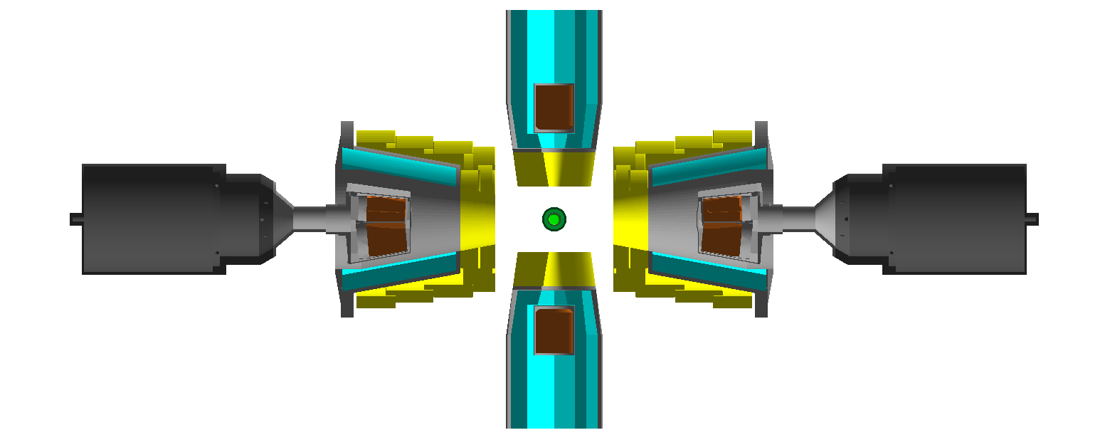
Experimental Setup
DT neutron
generator
90 s Irradiation
8 HPGe detectors (2 triple-cluster, 2 single-crystal)
Active Compton suppression with 4 BGO detectors + lead collimators
3 mm Pb and 5 mm Al shielding
Pneumatic tube system
~19 s transportation
Detection
setup
60 s measurement
8

Slide 20
Experimental Setup
DT neutron
generator
90 s Irradiation
8 HPGe detectors (2 triple-cluster, 2 single-crystal)
Active Compton suppression with 4 BGO detectors + lead collimators
3 mm Pb and 5 mm Al shielding
Pneumatic tube system
~19 s transportation
Detection
setup
60 s measurement
8

Slide 21
Experimental Setup
DT neutron
generator
90 s Irradiation
8 HPGe detectors (2 triple-cluster, 2 single-crystal)
Active Compton suppression with 4 BGO detectors + lead collimators
3 mm Pb and 5 mm Al shielding
Detection of γ rays emitted in coincidence
Pneumatic tube system
~19 s transportation
Detection
setup
60 s measurement
8

Slide 22
Experimental Setup
DT neutron
generator
90 s Irradiation
8 HPGe detectors (2 triple-cluster, 2 single-crystal)
Active Compton suppression with 4 BGO detectors + lead collimators
3 mm Pb and 5 mm Al shielding
Detection of γ rays emitted in coincidence
γ₁
γ₂
Pneumatic tube system
~19 s transportation
γ₁
γ₂
Detection
setup
60 s measurement
8

Slide 23
Experimental Setup
DT neutron
generator
90 s Irradiation
8 HPGe detectors (2 triple-cluster, 2 single-crystal)
Active Compton suppression with 4 BGO detectors + lead collimators
3 mm Pb and 5 mm Al shielding
Detection of γ rays emitted in coincidence
γ₁
γ₂
Pneumatic tube system
~19 s transportation
γ₁
γ₂
Detection
setup
60 s measurement
8

Slide 24
Experimental Setup
DT neutron
generator
90 s Irradiation
8 HPGe detectors (2 triple-cluster, 2 single-crystal)
Active Compton suppression with 4 BGO detectors + lead collimators
3 mm Pb and 5 mm Al shielding
Detection of γ rays emitted in coincidence
Pneumatic tube system
~19 s transportation
γ₁
γ₂
Detection
setup
60 s measurement
8

Slide 25
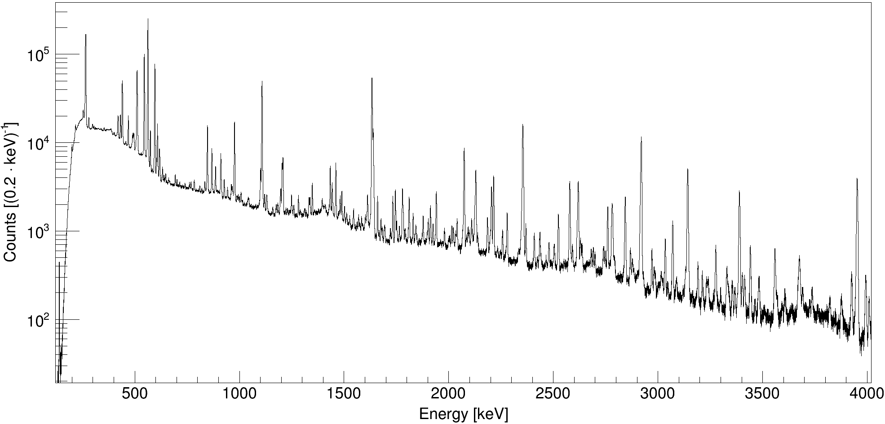
Summed Spectra Enriched Ge Sample
409 irradiation cycles
→ 3272 single spectra
More than 400 𝛾-ray transitions
9

Slide 26
Summed Spectra Enriched Ge Sample
Q_{ββ} = 2039 keV
409 irradiation cycles
→ 3272 single spectra
More than 400 𝛾-ray transitions
9

Slide 27
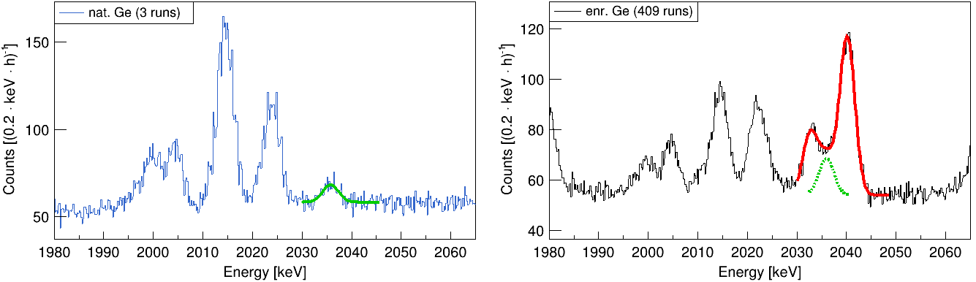
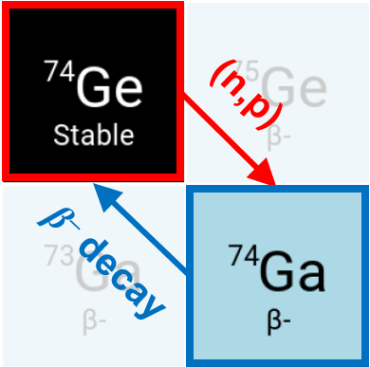
Summed Spectra near ⁷⁶Ge 0νββ Signal Region
Activation time: 10 min Activation time: 90 s
Timing window: 5 - 60 min Timing window: 0 - 60 s
Preliminary
2004.6
2014.45
2035
2045
1999.3
2023.9
2035.8
2032.8
2040.12
T_{½} = 8.12 min
10

Slide 28
Summed Spectra near ⁷⁶Ge 0νββ Signal Region
Activation time: 10 min Activation time: 90 s
Timing window: 5 - 60 min Timing window: 0 - 60 s
Preliminary
Preliminary
2004.6
2014.45
1999.3
2023.9
2035.8
2032.8
2040.12
T_{½} = 30.5 s
T_{½} = 8.12 min
11

Slide 29
Summed Spectra near ⁷⁶Ge 0νββ Signal Region
Activation time: 10 min Activation time: 90 s
Timing window: 5 - 60 min Timing window: 0 - 60 s
Preliminary
Preliminary
2004.6
2014.45
1999.3
2023.9
2035.8
2032.8
2040.12
T_{½} = 30.5 s
12

Slide 30
Summed Spectra near ⁷⁶Ge 0νββ Signal Region
Activation time: 10 min Activation time: 90 s
Timing window: 5 - 60 min Timing window: 0 - 60 s
Preliminary
Preliminary
2004.6
2014.45
1999.3
2023.9
2035.8
2032.8
2040.12
T_{½} = 30.5 s
T_{½} = 8.12 min
13

Slide 31
Summed Spectra near ⁷⁶Ge 0νββ Signal Region
Pichotta et al.,
Phys. Rev. C 112, 014325 (2025)
Activation time: 10 min Activation time: 90 s
Timing window: 5 - 60 min Timing window: 0 - 60 s
Preliminary
Preliminary
2004.6
2014.45
1999.3
2023.9
2035.8
2032.8
2040.12
T_{½} = 30.5 s
T_{½} = 8.12 min
13

Slide 32
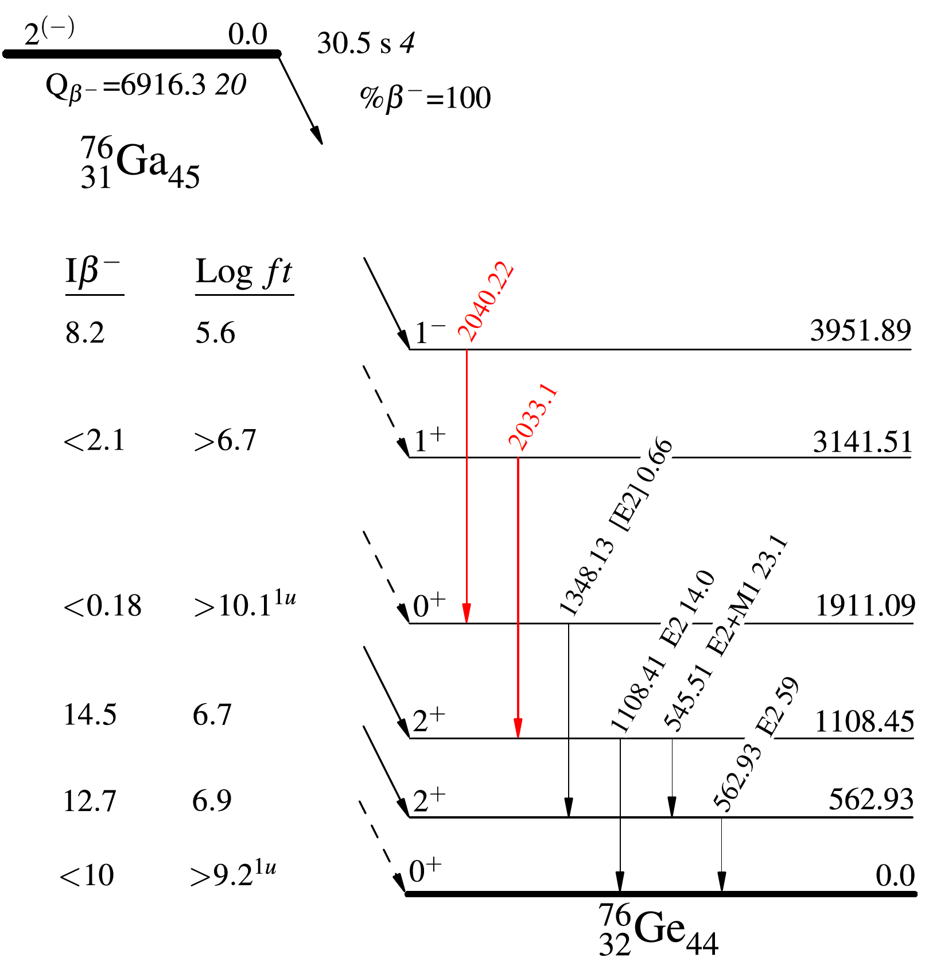
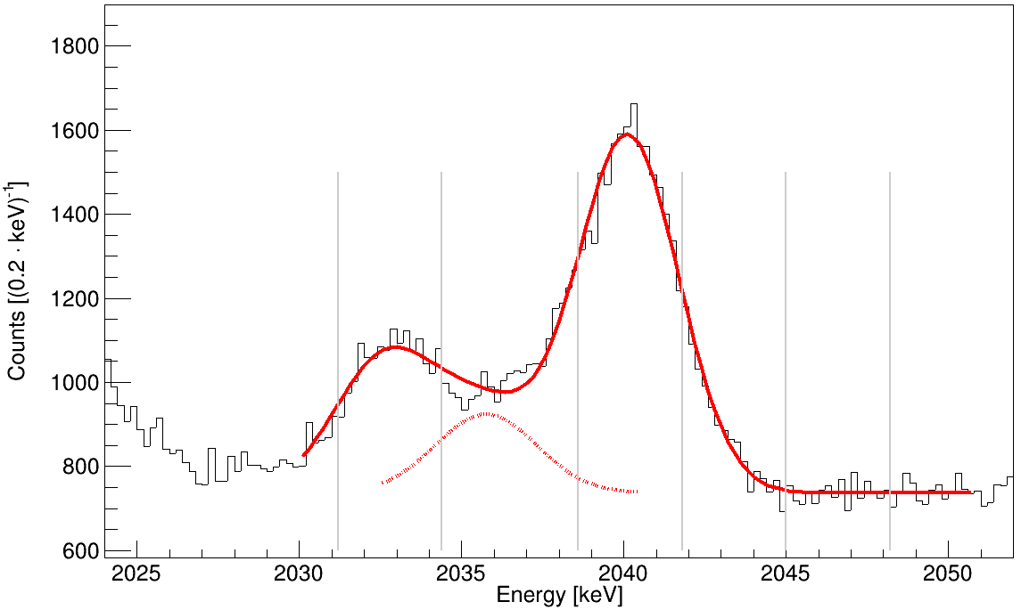
𝛾-𝛾 Coincidence Analysis
Cut conditions:
What do the other detectors measure when
one detector records an event in the ROI?
+ BGO veto
+ …
ROI
2040
Preliminary
ROI
2032
ROI
BG
14

Slide 33
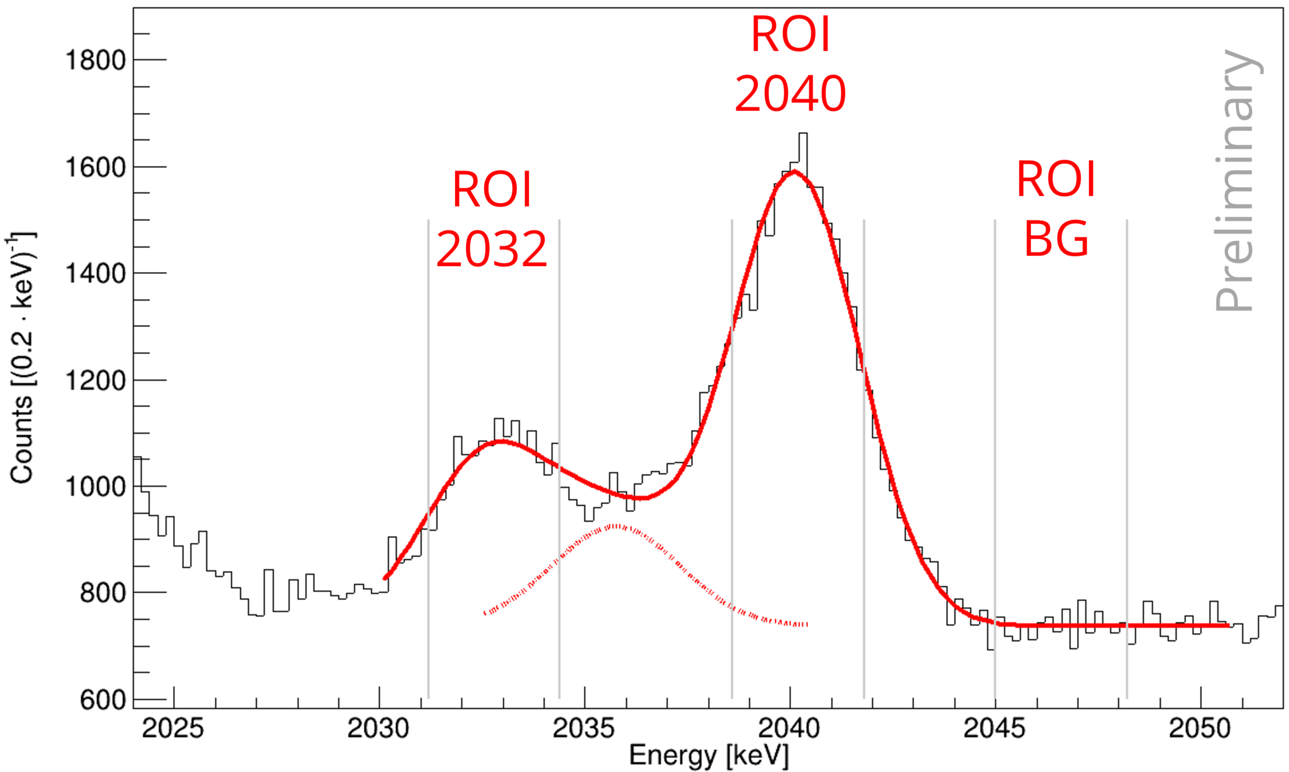
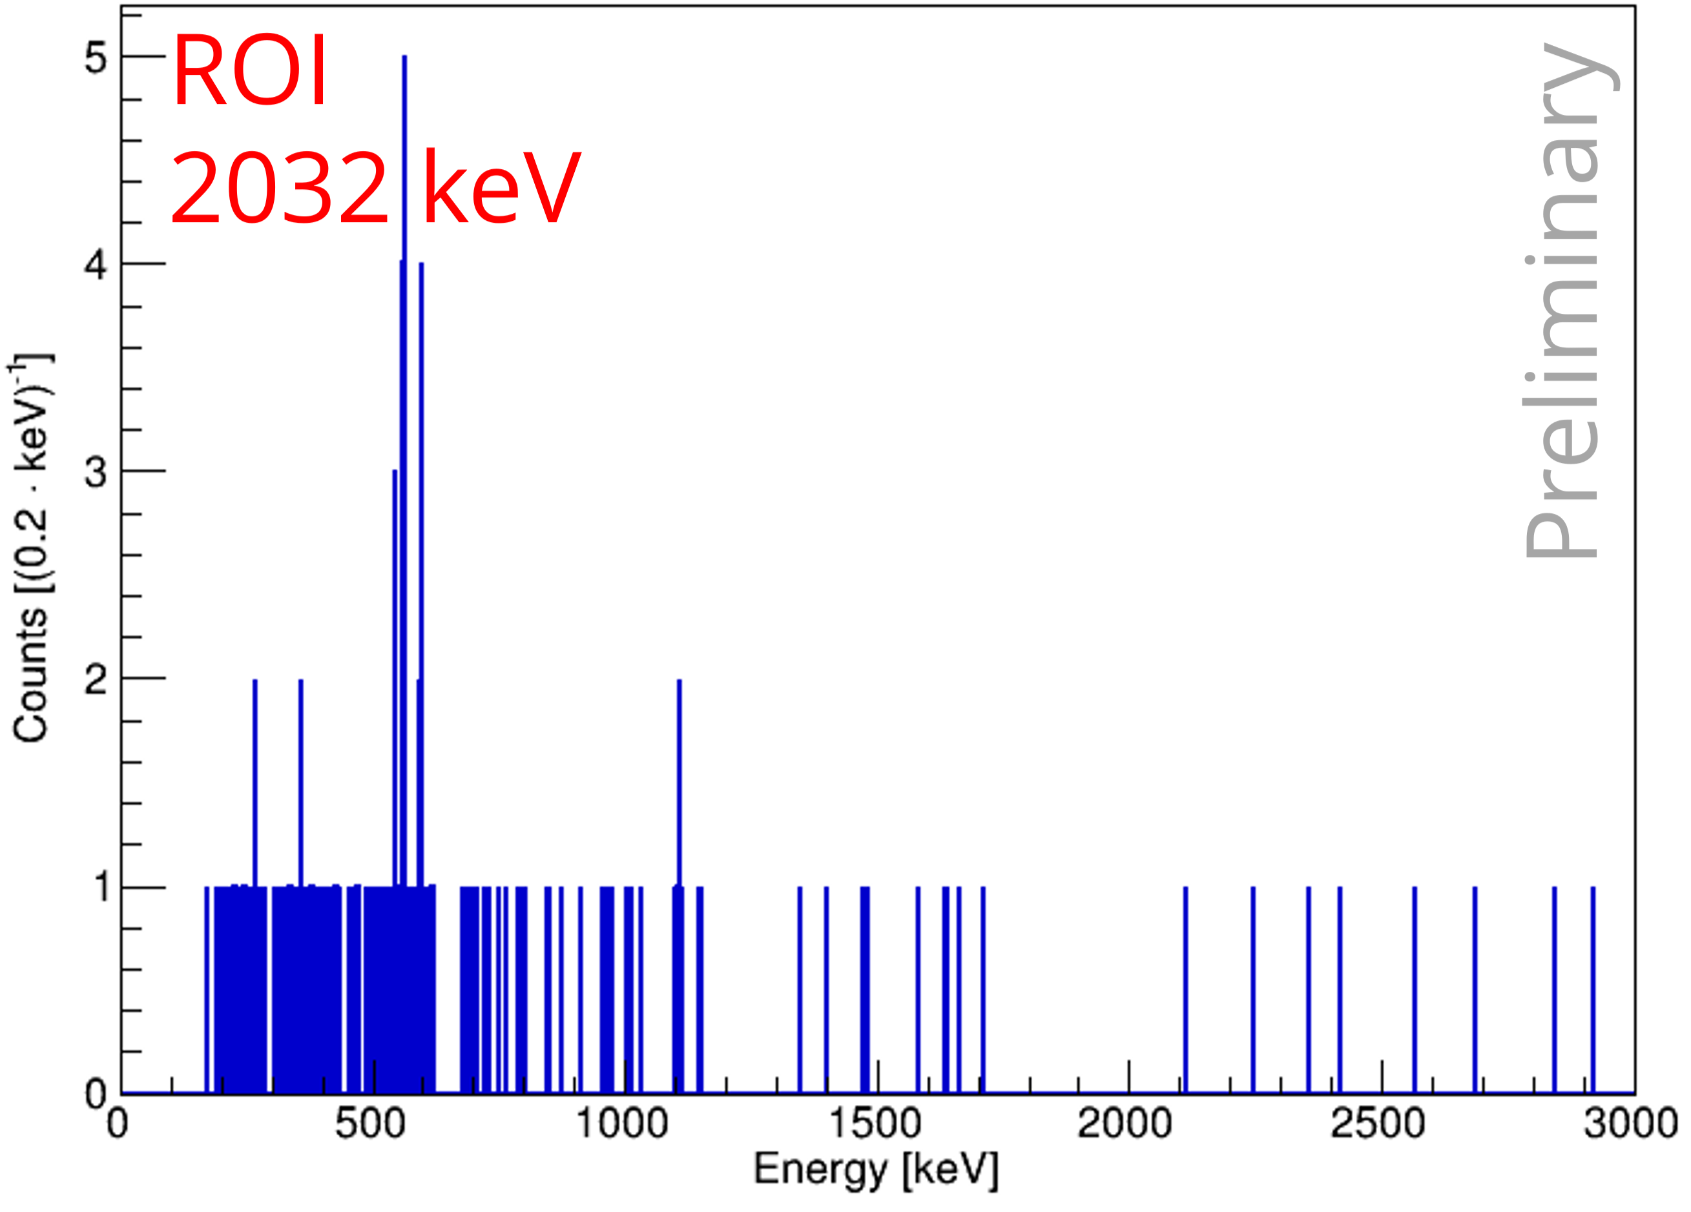
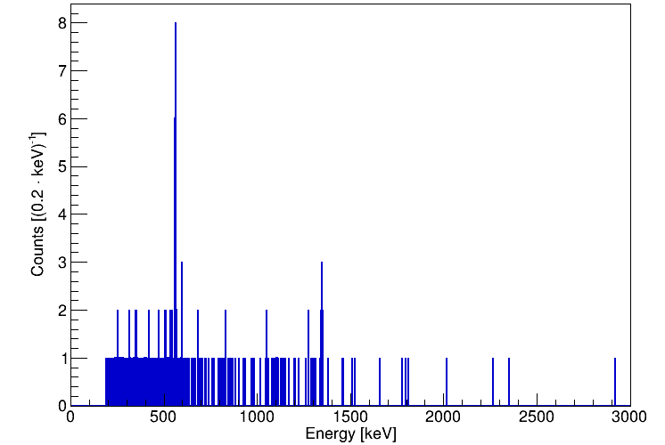
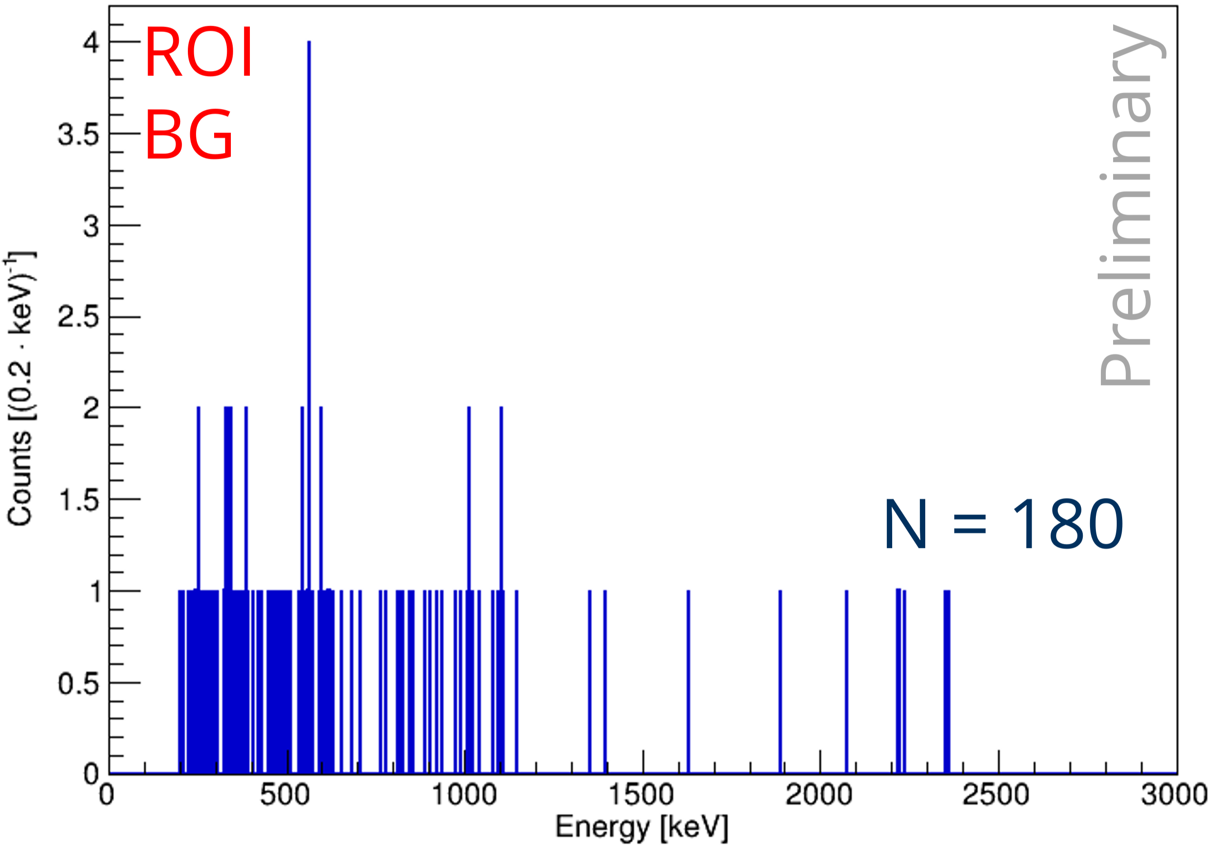
𝛾-𝛾 Coincidence Analysis
ROI
2040 keV
Preliminary
N = 293
N = 460
15

Slide 34
𝛾-𝛾 Coincidence Analysis
N = 293
15

Slide 35
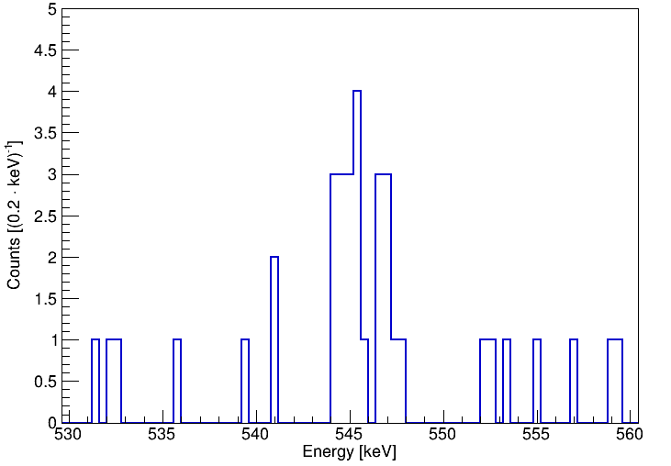
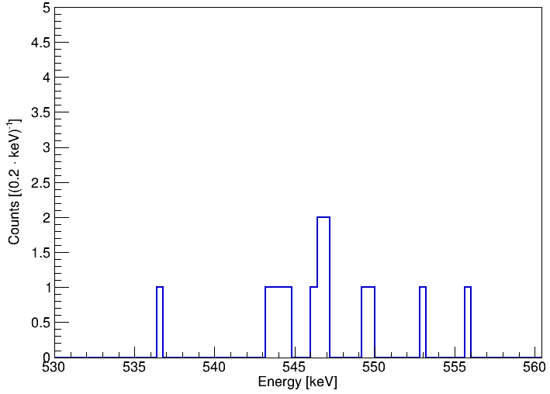

𝛾-𝛾 Coincidence Analysis
ROI
2032 keV
N = 22
Preliminary
2040.22
ROI
BG
N = 5
Preliminary
16

Slide 36
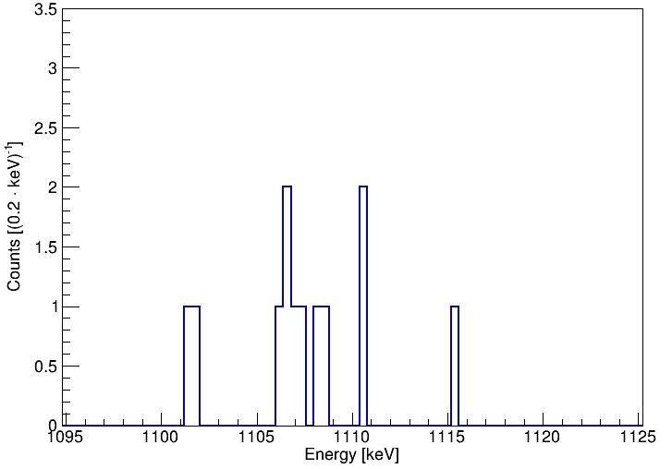
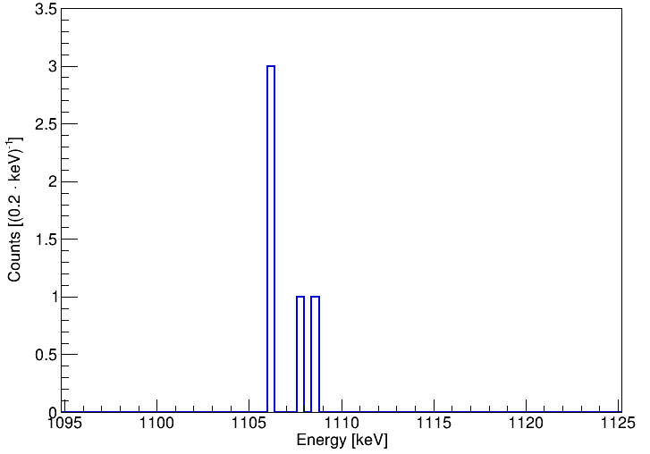
𝛾-𝛾 Coincidence Analysis
ROI
2032 keV
N = 9
Preliminary
2040.22
ROI
BG
N = 5
Preliminary
17

Slide 37
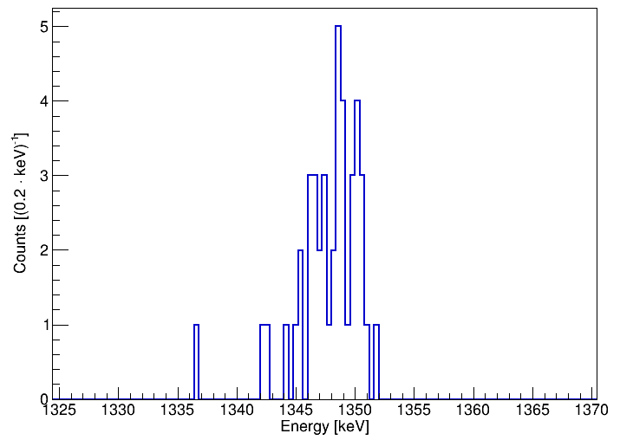
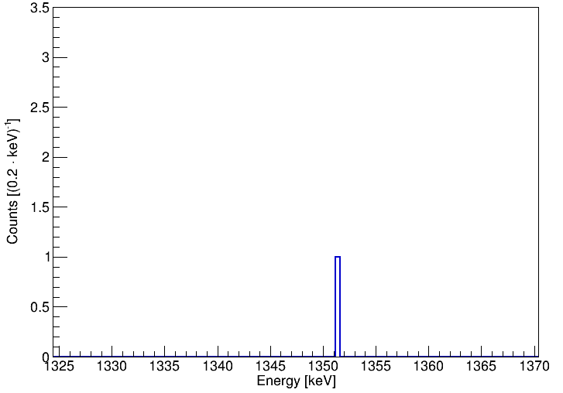
𝛾-𝛾 Coincidence Analysis
ROI
2040 keV
N = 42
Preliminary
2033.1
ROI
BG
N = 1
Preliminary
18

Slide 38
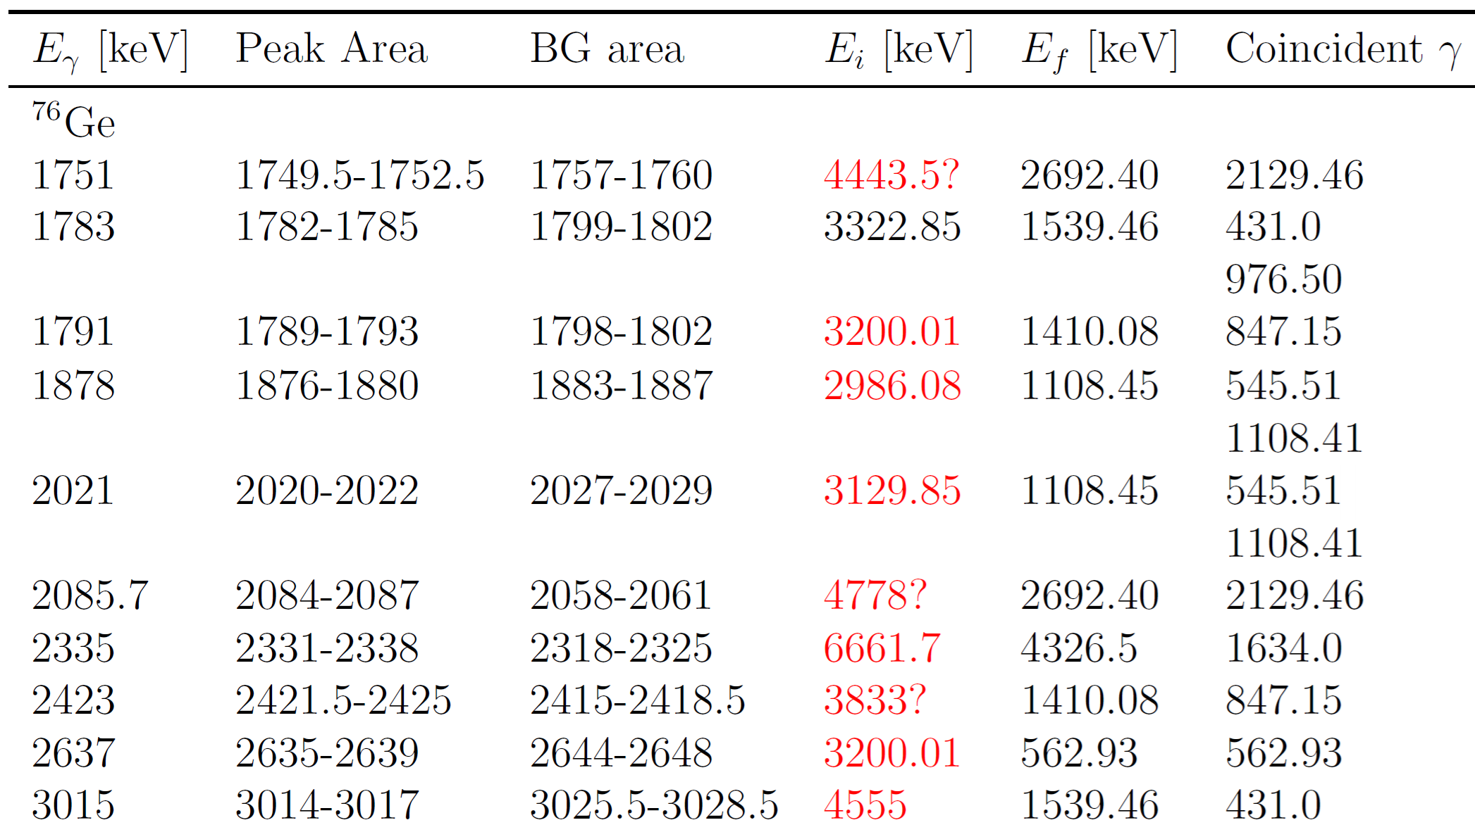
𝛾-𝛾 Coincidence Analysis & Outlook
Multiple unknown ⁷⁶Ga 𝛾-ray transitions investigated via γ-γ coincidence analysis
→ Filling the gaps in the ⁷⁶Ga decay scheme
Very preliminary
To be continued…
19

Slide 39

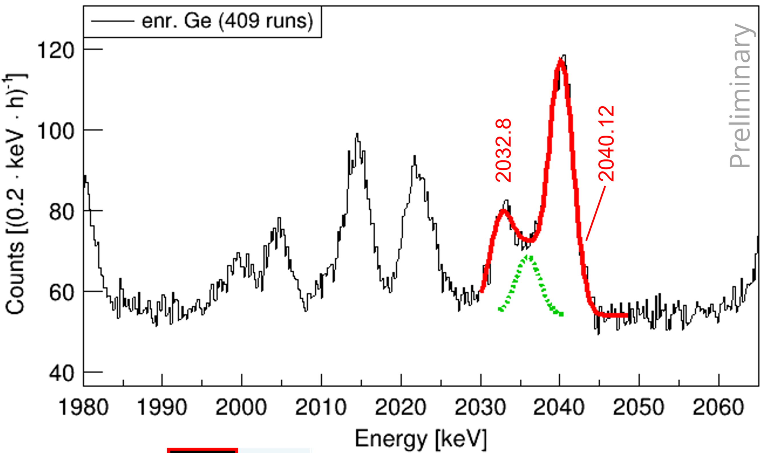
Summary
Pichotta et al.,
Phys. Rev. C 112, 014325 (2025)
Multiple γ-ray transitions near Q_{ββ} = 2039 keV detected
E_{γ} = 2032.8 keV from ⁷⁶Ga
E_{γ} = 2035.8 keV from ⁷⁴Ga
E_{γ} = 2040.12 keV from ⁷⁶Ga
→ Isotopically enriched Ge itself can contribute to potential
background for ⁷⁶Ge 0νββ decay experiments
Identification of the origin of these γ rays in the decay scheme using γ-γ coincidence analysis currently ongoing
Applying γ-γ coincidence analysis to newly observed peaks and
γ-ray transitions of previously unknown origin
Outlook
20

Slide 40
Literature
^{[1]} D. C. Camp, D. R. Fielder, and B. P. Foster, “Energy levels in ⁷⁴Ge from the decay of ⁷⁴Ga”, Nucl. Phys. A, 163(1):145 – 160,
1971
^{[2]} H. W. Taylor et al., “The decay of 8.0 min ⁷⁴Ge”, Can. J. Phys., 53:107, 1975
^{[3]} D. C. Camp and B. P. Foster, “Energy levels in ⁷⁶Ge from the decay of ⁷⁶Ga”, Nucl. Phys. A, 177:401–417, 1971
^{[4]} B. P. Crider, “Inelastic neutron scattering cross sections for ⁷⁶Ge relevant to background in neutrinoless double-β decay
experiments”, Phys. Rev. C 92, 034310, 2015
^{[5]} S. Mukhopadhyay et al., “Nuclear structure of ⁷⁶Ge from inelastic neutron scattering measurements and shell model
calculations”, Phys. Rev. C 95, 014327, 2017
^{[6]} C. Rouki et al., “𝛾 production and neutron inelastic scattering cross sections for ⁷⁶Ge“, Phys. Rev. C 88, 054613, 2013
^{[7]} A. Domula et al., “New Nuclear Structure and Decay Results in the ⁷⁶Ge - ⁷⁶As System”, Nucl. Data Sheets 120 4447, 2014
^{[8]} A. Domula, “Neutronenphysikalische Studien an Germanium für Experimente zum neutrinolosen Doppelbetazerfall von ⁷⁶Ge”,
PhD thesis, 2013
^{[9]} W. Tornow et al., “Fast-neutron-induced potential background near the Q value of neutrinoless double-β decay of ⁷⁶Ge”, Phys.
Rev. C 93, 014614, 2016
^{[10]} R. Schwengner et al., “Photoexcitation of ⁷⁶Ge”, Phys. Rev. C 105, 024303, 2022

Slide 41
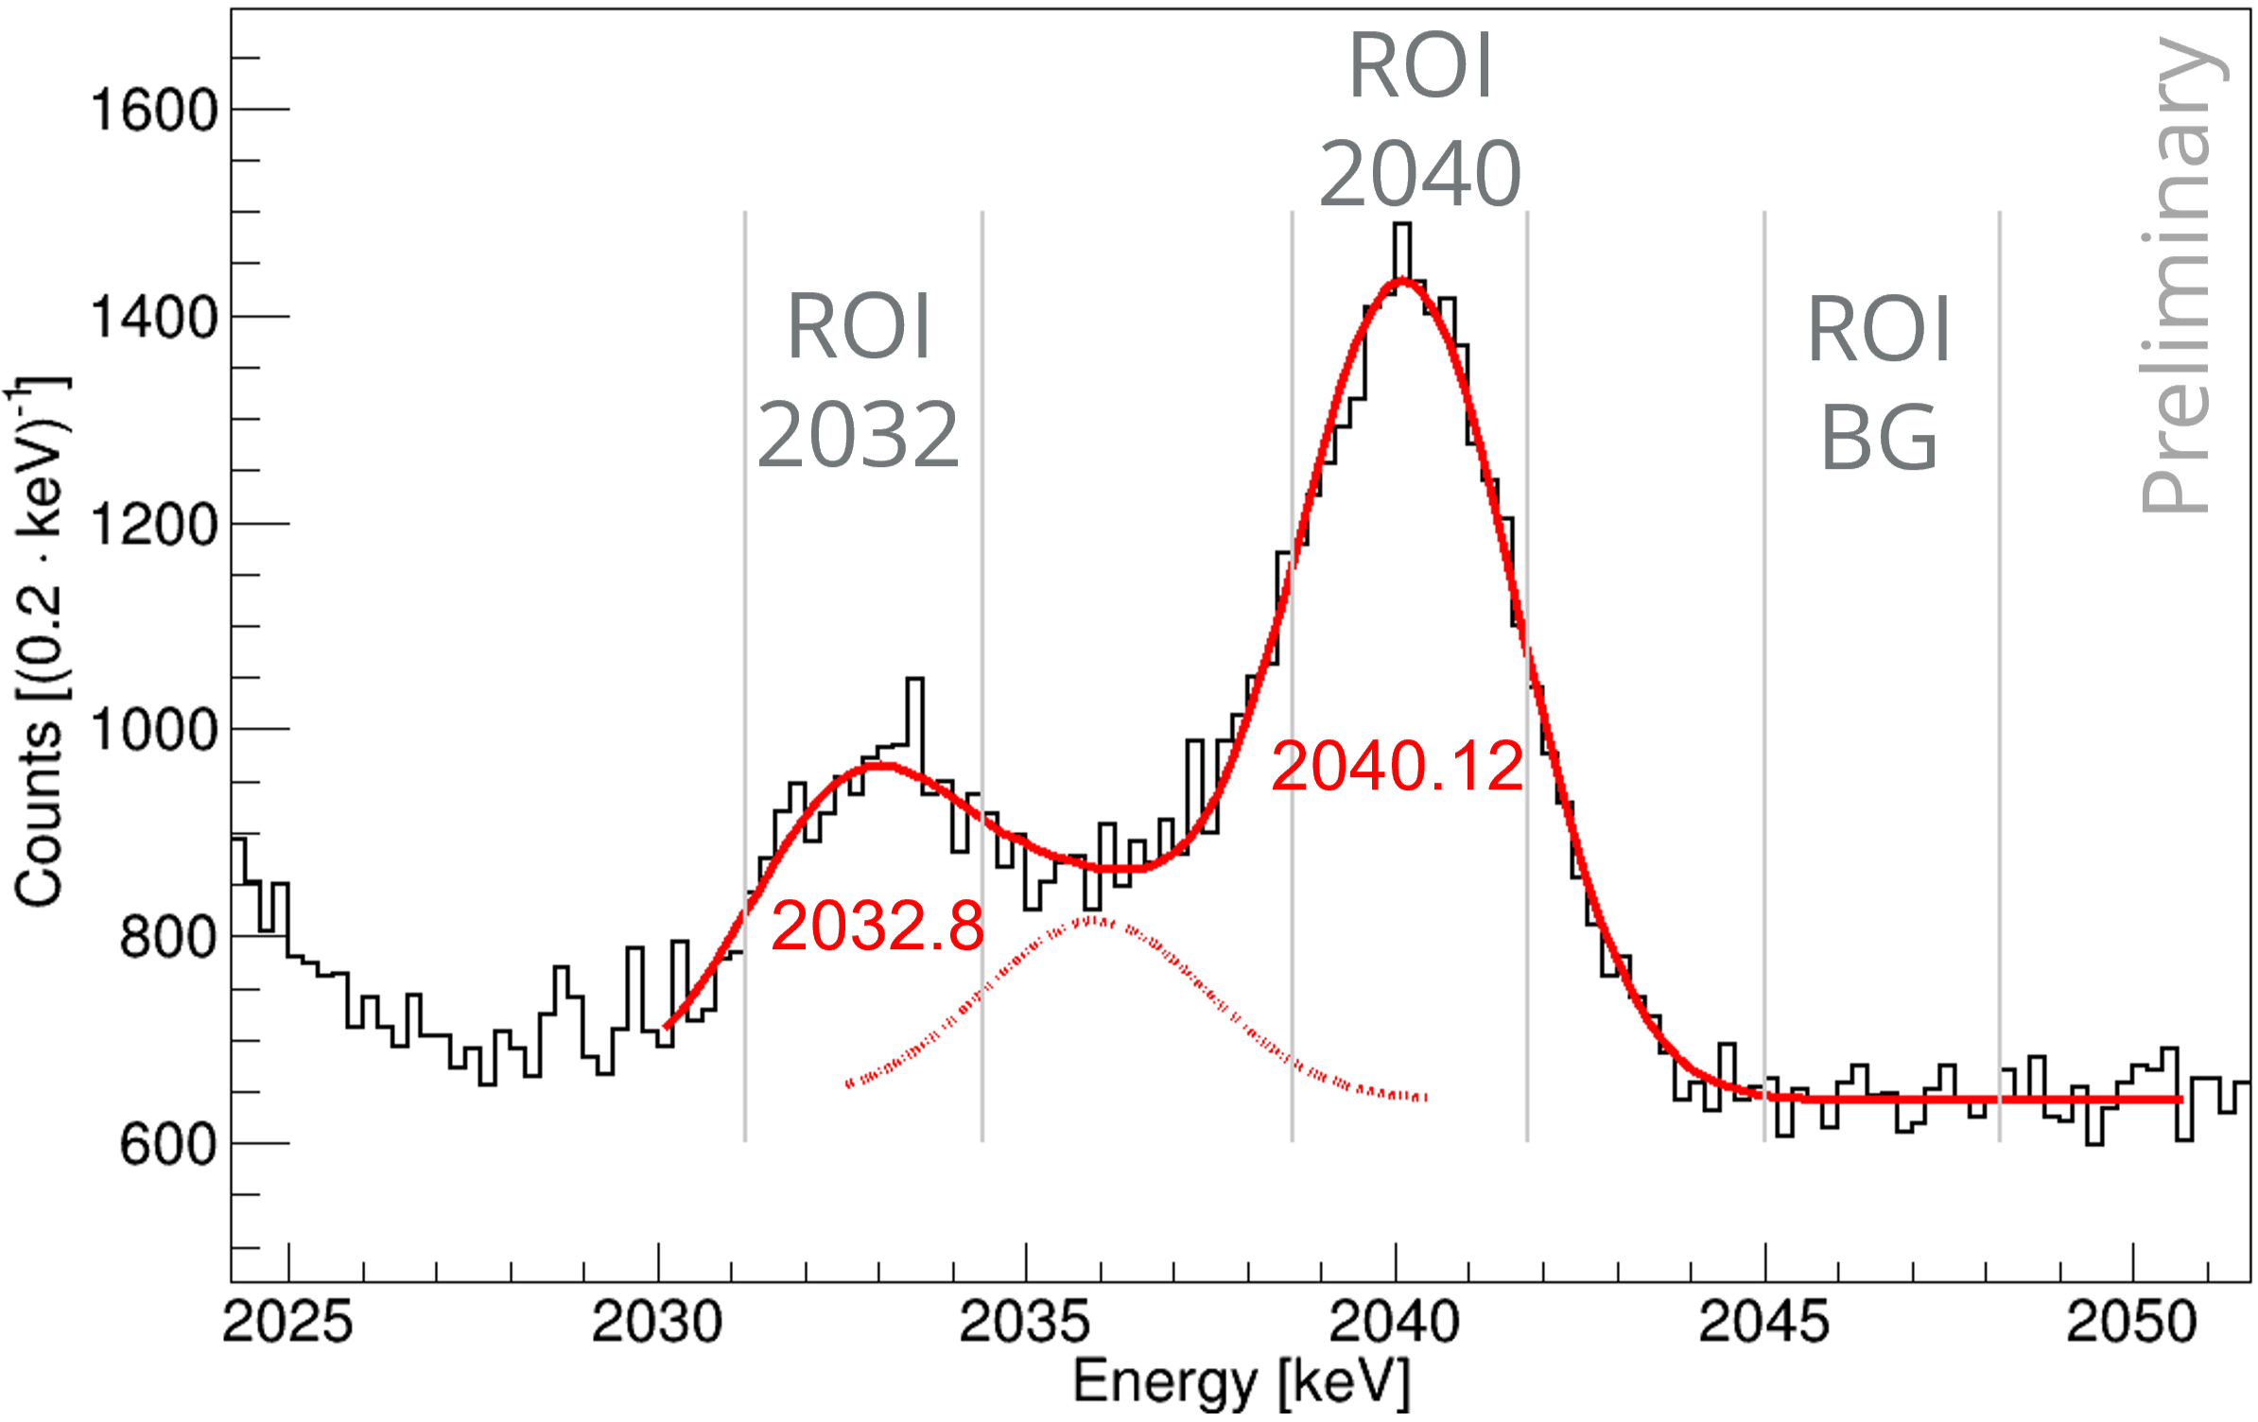
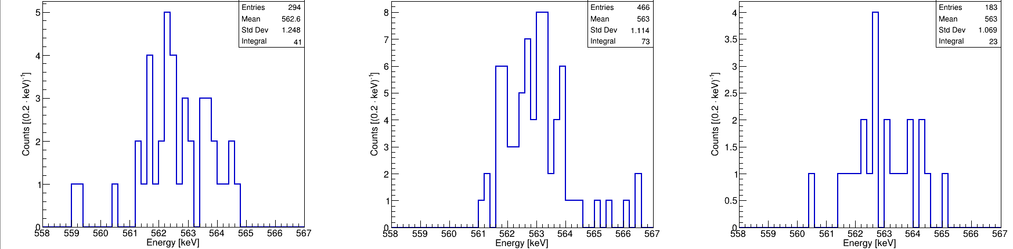
𝛾-𝛾 Coincidence Analysis
ROI
2032 keV
ROI
2040 keV
ROI
BG
Preliminary
Preliminary
Preliminary

Slide 42
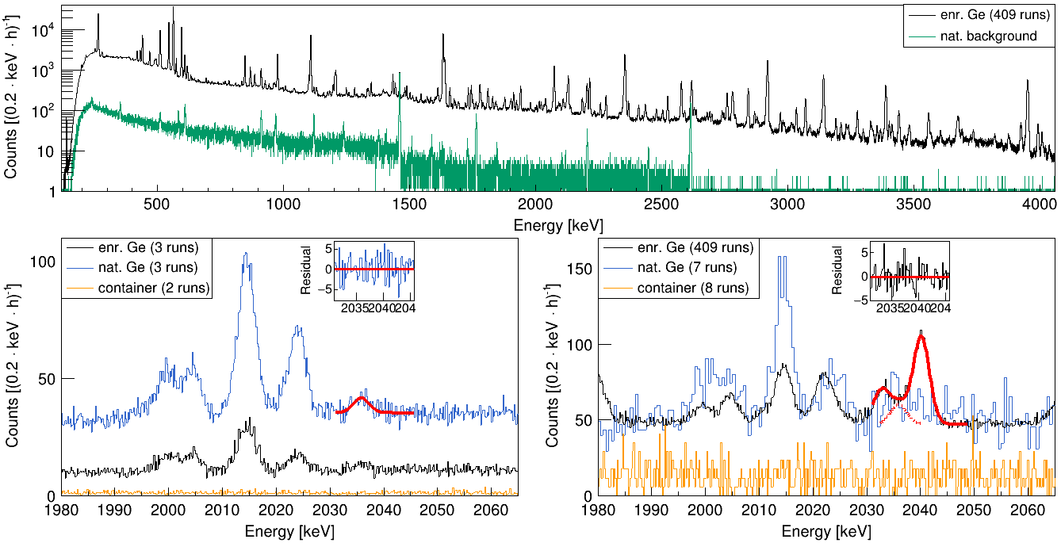
Results
Preliminary
Preliminary
Preliminary

Slide 43
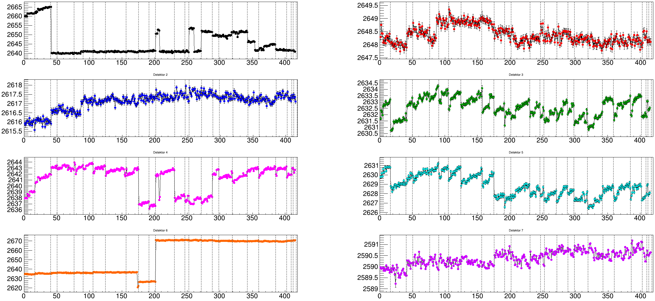
Channel Stability HPGe Detectors
Detector 1
Detector 2
Detector 3
Detector 4
Detector 5
Detector 6
Detector 7
Detector 8

Slide 44
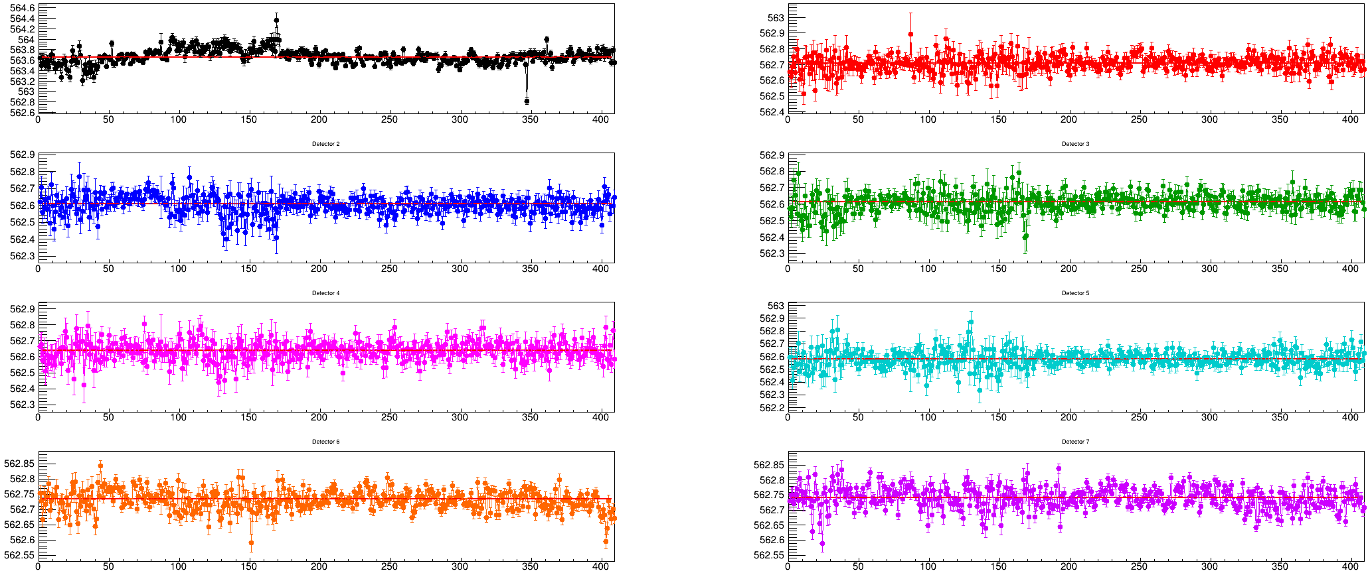
Energy Calibration Stability HPGe Detectors
Detector 1
Detector 2
Detector 3
Detector 4
Detector 5
Detector 6
Detector 7
Detector 8

Slide 45
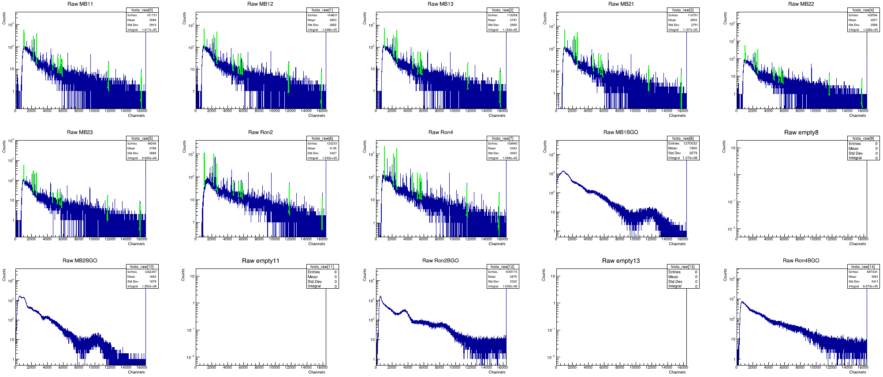
Energy Calibration

Slide 46
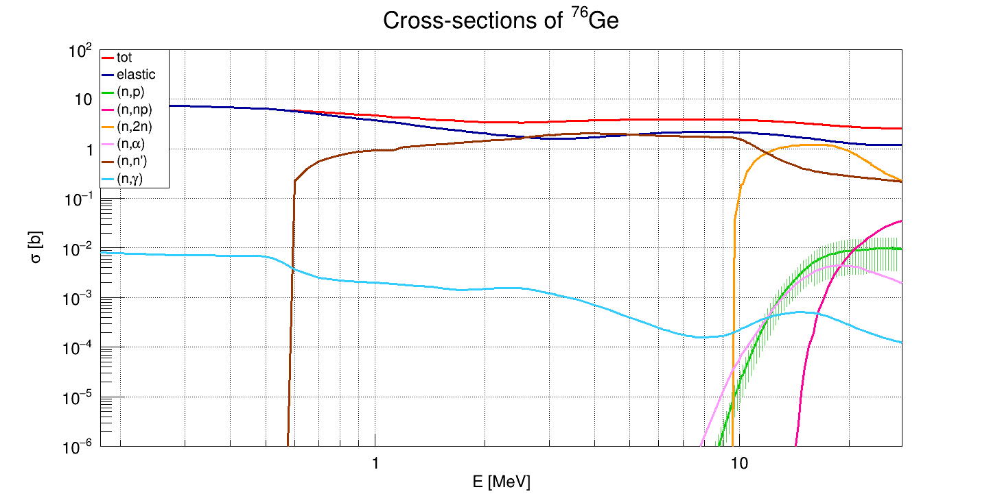
Neutron-Induced γ Rays in the ⁷⁶Ge 0νββ Signal Region?
Background contribution from enriched Ge due to neutron activation of ⁷⁶Ge and ⁷⁴Ge
Neutron cross sections ⁷⁶Ge
14 MeV

Slide 47
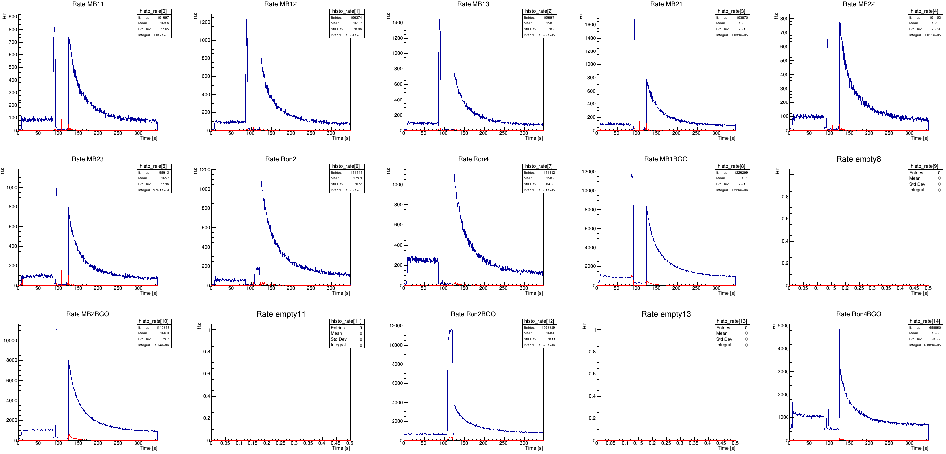
Counting raste

Slide 48
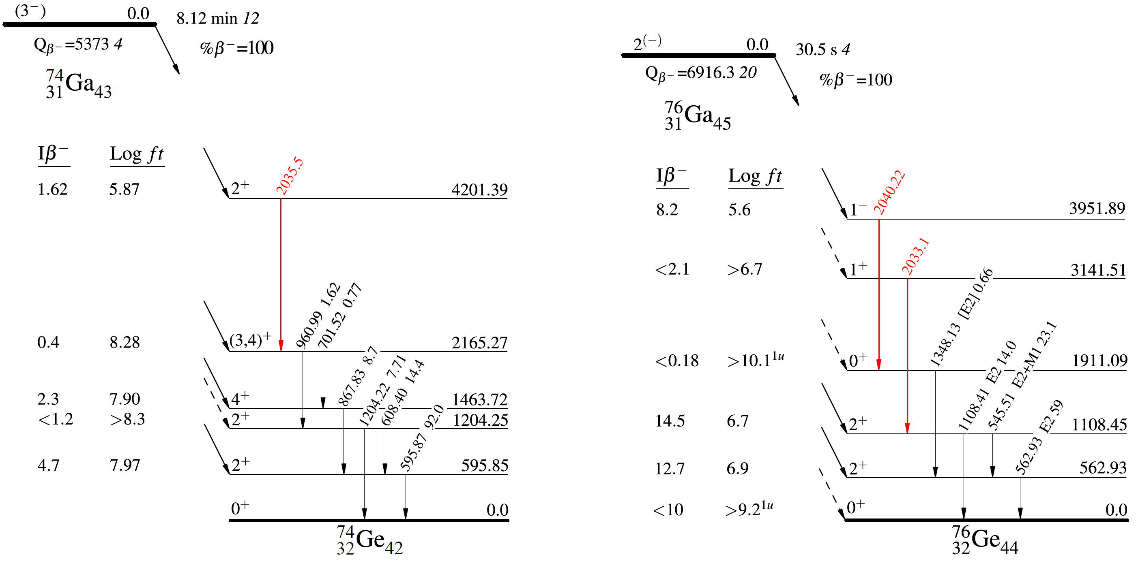
Decay schemes

Slide 49
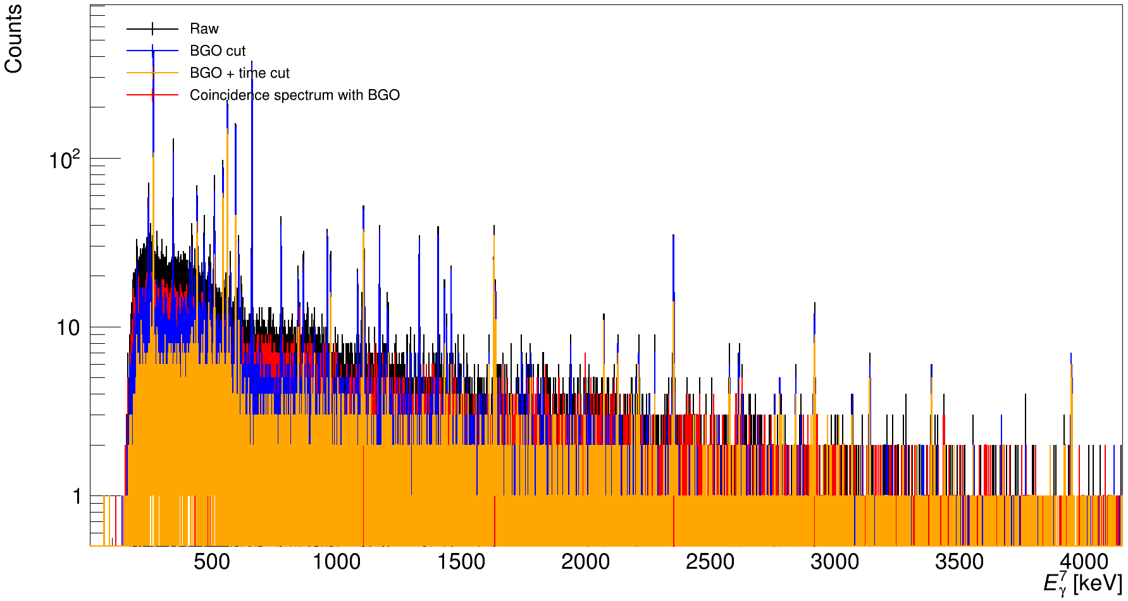
Data Cuts

